Slide 1
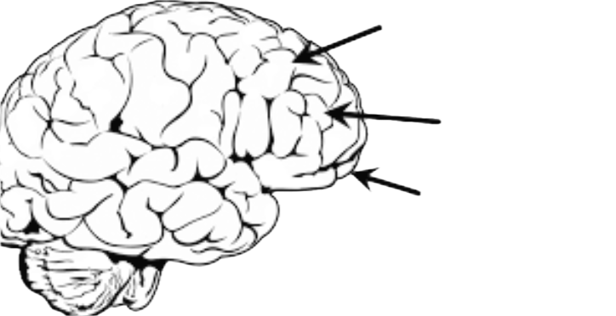
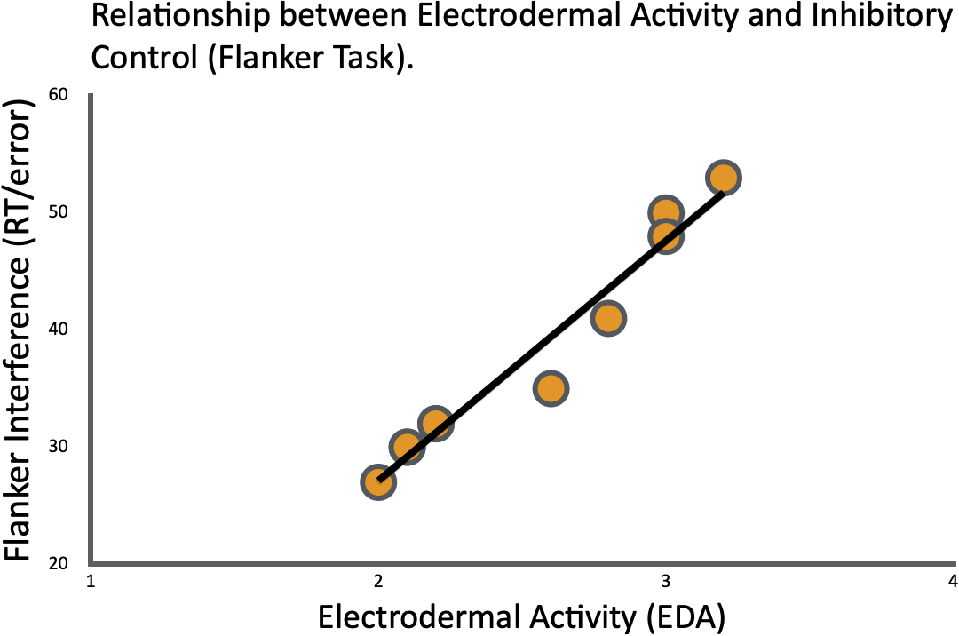
Effects of Low-level salience on autonomic nervous system activity and inhibitory control
Jl21379@essex.ac.uk Joanne Leslie –Department of Psychology University of Essex Online
Abstract
Research Design & Method
Limitations
Examines how low-level salience influences Autonomic Nervous System (ANS) activity and executive Function (EF)/inhibitory Control.
Salience effects underexplored beyond clinical/stress contexts.
Within subjects (N=34)
Non-Salience
EDA (autonomic activity)
Flanker Task (inhibitory control)
Low-level Salience
EEG (N2 activity)
Correlational design: cannot establish causation.
Flanker task: limited ecological validity (lab-based measure of EF).
EDA variability: influenced by external and individual factors.
Sample size determined by a priori power analysis (G*Power), however may limit generalisability.
Introduction
PFC regions support EFs: dorsolateral (working memory), ventrolateral (inhibitory control), and orbitofrontal (emotion) (Ward, 2020).
References
Predicted trend (salience):
↑ EDA
↓ inhibitory control (↑ errors, slower RT)
EEG: ↑ N2 amplitude
Arnsten, A. F. T. (2009). Stress signalling pathways that impair prefrontal cortex structure and function. Nature Reviews Neuroscience, 10(6), 410-422. https://doi.org/10.1038/nrn2648
Diamond, A. (2013). Executive functions. Annual Review of Psychology, 64, 135-168. https://doi.org/10.1146/annurev-psych-113011-143750
Thayer, J. F., Hansen, A. L., Saus-Rose, E., & Johnsen, B. H. (2009). Heart rate variability, prefrontal neural function, and cognitive performance: The neurovisceral integration perspective on self-regulation, adaptation, and health. Annals of Behavioural Medicine, 37(2), 141-153. https://doi.org/10.1007/s12160-009-9101-z
Valenza, G., Passamonti, L., Duggento, A., Toschi, N., & Barbieri, R. (2020). Uncovering complex central autonomic networks at rest: a functional magnetic resonance imaging study on complex cardiovascular oscillations. Journal of the Royal Society Interface, 17(164), 20190878. https://doi.org/10.1098/rsif.2019.0878
Ward, J. (2020). The student’s guide to cognitive neuroscience (4th Ed.). Routledge.
dlPFC
Working Memory
vlPFC
Inhibitory control
Ethics: Informed consent, study briefing and pre-screening (STICSA) provided.
Data anonymised, securely stored.
Non-invasive EEG/EDA. (mild discomfort/skin irritation; breaks & withdrawal anytime). Participants monitored throughout.
Expected
Results:
vmPFC
Emotion/Value
Healthy EF develops progressively with PFC maturation and is influenced by physiological/ environmental conditions (Diamond, 2013).
PFC overlaps with ANS regulatory networks; parasympathetic activity supports EF by maintaining PFC regulation (Thayer et al., 2009).
In contrast, Sympathetic activity disrupts PFC control, shifting toward automatic, amygdala-driven responses (Arnsten, 2009).
ANS activity fluctuates even at rest, indicating continuous influence on EF (Valenza et al., 2020).
Research Question: To what extent does low-level salience activate the autonomic nervous system, and do these changes influence inhibitory control performance across individuals?
Individual Variability:
EDA
EEG
Flanker

